Slide 1
Data Depiction in Forensic Perspective
Abhishek Prajapati
Research Scholar
National Forensic Sciences University

Slide 2
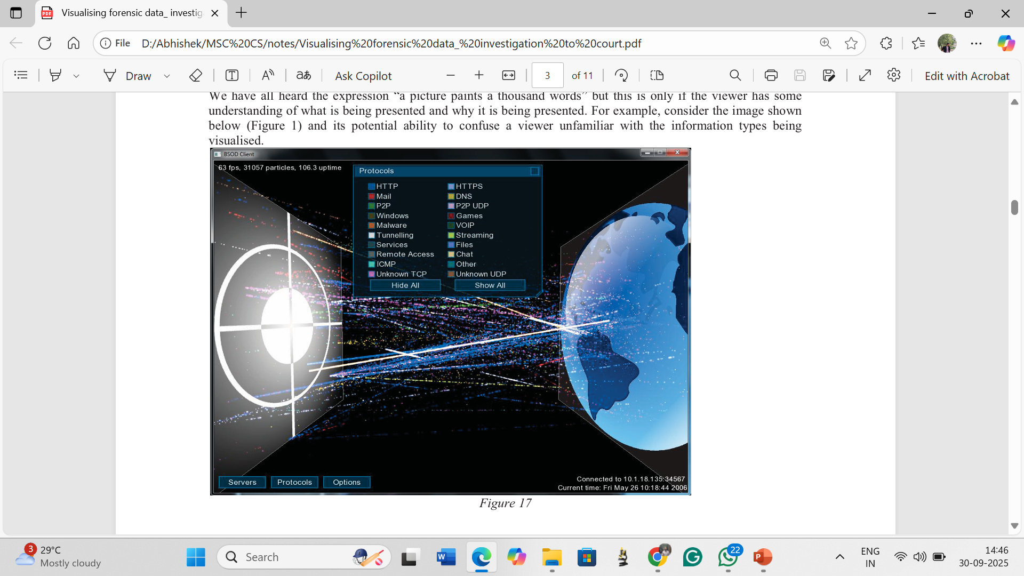
“A picture paints a thousand words” if the viewer has some understanding of what is being presented and why it is being presented.
The image above (Wand, n.d.) shows computer network traffic in a graphical format, the data is captured from a live network interface, visualising the flow of network data between hosts, providing (at a glance) information about network usage. To the trained person in computer network traffic analysis the image has meaning and provides displays information but to the layperson it will require the provision of a detailed explanation. How information and data is viewed, interpreted and understood depends on what is presented, to whom it is presented and why it is being presented. Visualisations are only effective when the right kind of pictorial representation is chosen and can be manipulated to show useful information (Lowman 2010).

Slide 3
Introduction
Definition: Data depiction = methods to visually represent and interpret data collected from a crime scene.
Importance: Makes complex information easier to understand for forensic experts, law enforcement, and courts.
Purpose:
Clarifies chaotic information
Identifies patterns & connections
Provides insights into how the crime occurred

Slide 4
Types of Crime Scene Data
1. Physical Evidence Data
Fingerprints, blood spatters, fibers, weapons
Mapped to show relationships
2. Environmental Data
Lighting, weather, time of day
Captured real-time for accuracy
3. Witness & Victim Data
Statements visualized via timelines & maps
Helps cross-check accounts with evidence

Slide 5
Tools & Methods for Data Depiction
Photography/Videography: High-resolution & 360° views
Sketching/Mapping:
2D sketches for initial layouts
3D mapping with CAD & laser scanning
Digital Modeling: Virtual walkthroughs & event reconstruction
Data Analytics Software: Tools like Tableau/SPSS for statistical patterns

Slide 6
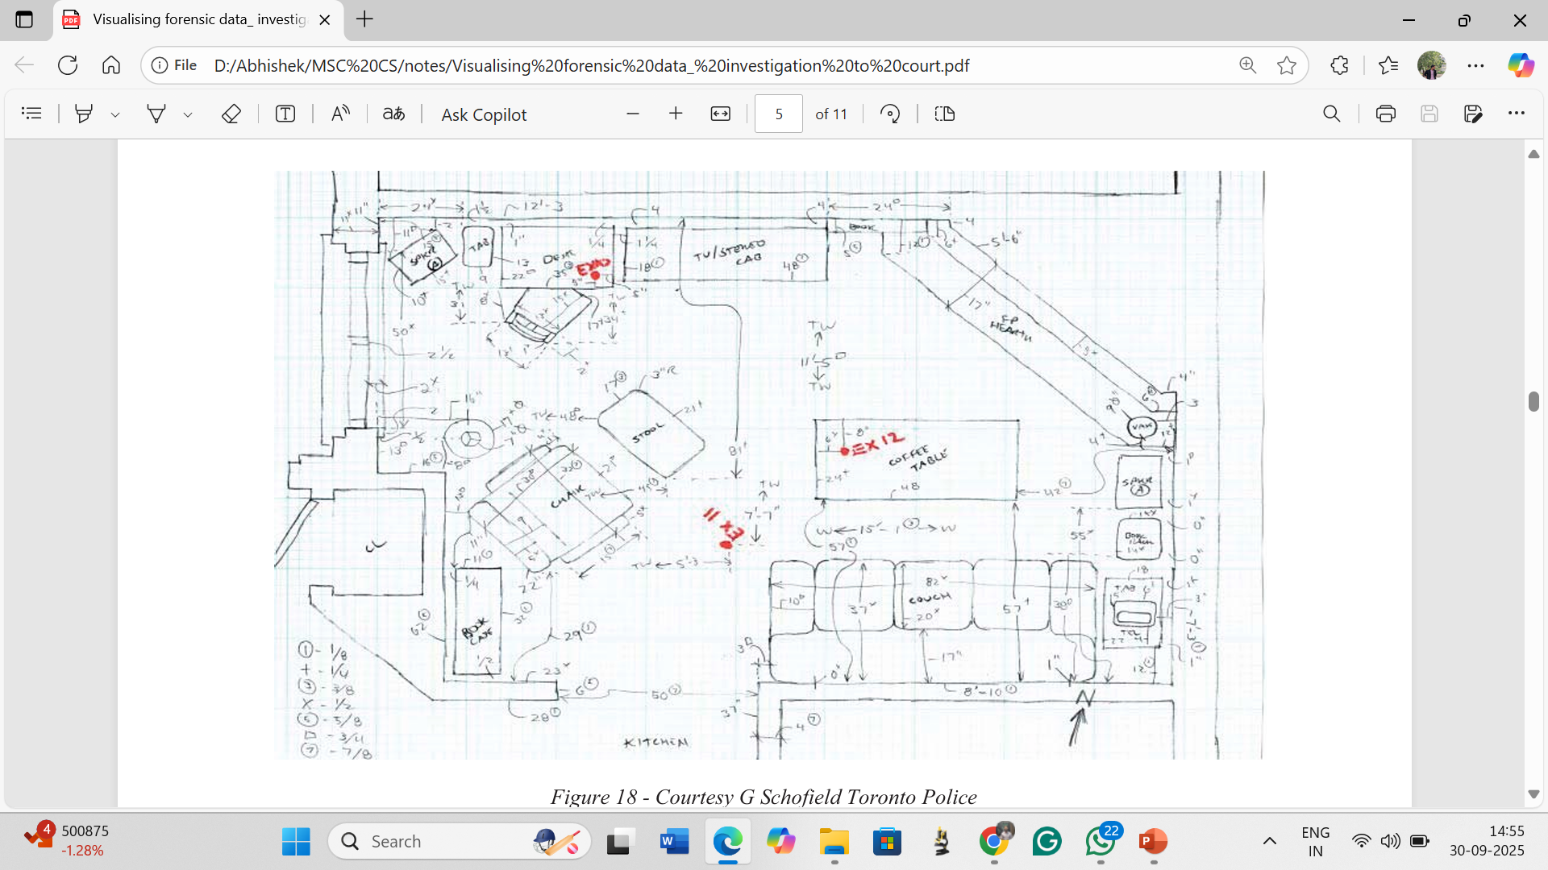
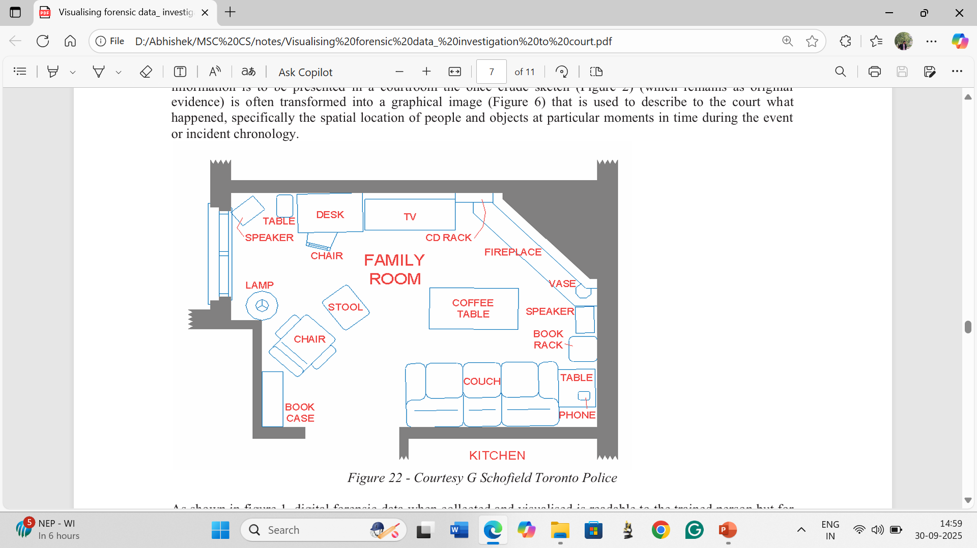
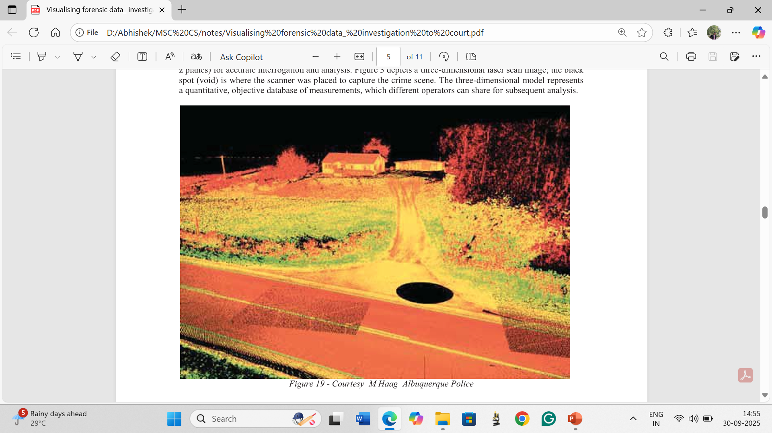
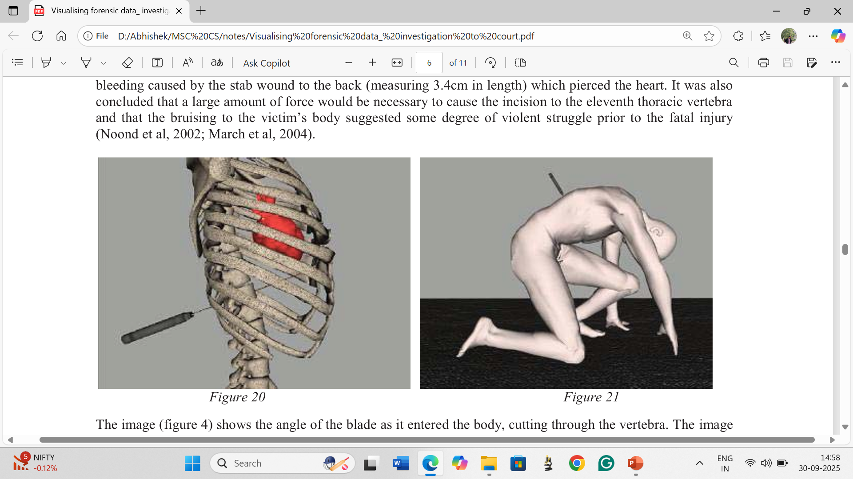
Rough sketch
Final sketch
3D laser scanning
Digital modelling

Slide 7
Applications in Crime Analysis
Heat Maps: Highlight areas with most evidence/activity
Timeline Diagrams: Establish event sequences (e.g., entry, witness reports, evidence collection)
Geospatial Mapping: Track suspect/victim movement; useful in serial cases

Slide 8
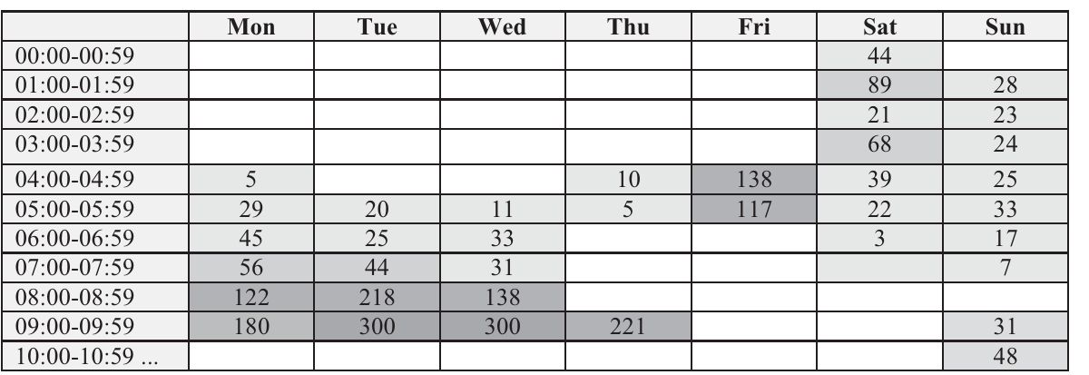
Below figure shows internet usage of a suspect’s computer using a heat map in shades of grey. The data reveals peak activity on Monday–Wednesday (05:00–09:59) and weekends (00:00–06:59), with the highest use between 09:00–09:59.

Slide 9
Advantages of Effective Data Depiction
Enhanced clarity for experts & judges
Improved accuracy in documentation
Supports hypothesis testing (e.g., event reconstruction)
Strong courtroom aid – engages judges/jurors with visual evidence

Slide 10
Challenges & Limitations
Technical complexity → requires trained personnel
Data gaps or tampering → risk of misleading visuals
Privacy & ethics → must comply with data protection laws

Slide 11
Role of Data Visualization & Big Data
Data Visualization: Graphs, charts, maps → reveal patterns, trends, anomalies
Big Data Integration:
Handles large/complex forensic datasets
Identifies fraud, repetitive offender patterns
Speeds reporting & decision-making

Slide 12
Data Visualization in Investigation Reports
Makes reports user-friendly for legal & non-legal professionals
Infographics improve clarity & impact
Enhances decision-making for management/boards
Helps overcome information overload

Slide 13
Best Practices in Data Visualization
Ensure reliability of data sources
Verify statistical significance of trends
Document assumptions & exclusions
Use visuals that:
Drive substance, not just design
Allow comparisons across data
Reveal details at multiple levels

Slide 14
The Way Forward
Digital revolution = new forms of evidence (e.g., digital images, videos, hard drives)
Future tools:
AI-driven analytics (predictive crime mapping)
Augmented/Virtual Reality (immersive crime scene reconstructions)
Trend: More precise & sophisticated analysis

Slide 15
Conclusion
Data depiction techniques = powerful aids in forensic investigations
Organize & simplify complex crime scene information
Improve accuracy, clarity, and communication in court
Future-ready: Integration of AI, AR, and big data → next-gen forensic tools

Slide 16
References
[1] Shannon,C. “A mathematical theory of communication,” in The Bell System Technical Journal, vol. 27, no. 3, pp. 379-423, July 1948.
[2] Hiroyuki, K. Infographics ; Flag Technology: Taipei, Taiwan, 2010.
[3] Data Visualization in Society, Amsterdam University Press (2020). Martin Engebretsen and Helen Kennedy.
[4] Tu and Wang (2018), “An Investigation of the Effects of Infographics and Green Messages on the Environmental Attitudes of Taiwanese Online Shoppers” Sustainability, November 2018. https://doi.org/10.3390/su10113993.
[5] https://globalinvestigationsreview.com/guide/the-aci-corporate-investigators-handbook-in-association-gir/first-edition/article/information-and-data-presentation?utm_source=GIR&utm_medium=pdf&utm_campaign=The+ACi+Corporate+Investigator%E2%80%99s+Handbook+in+association+with+GIR
[6] Fowle, K., & Schofield, D. (2011). Visualising forensic data: investigation to court.
[7 https://www.studocu.com/in/document/nirma-university-of-science-and-technology/vlsi-design/data-depiction-at-crime-scene-helly/115469341]

